Slide 1
Going Live

Slide 2
Objectives
In todays class we will…
Recap the basic topics covered to date
Offer a conceptual introduction to CSS reset and downloadable style sheets
Work with Google Developer tools for site inspection
Utilize Github Pages for website deployment

Slide 3
Check-Up Session
How’s it going?
After 1 week of Bootcamp, how are you holding up?
What feedback do you have so far?

Slide 4

Instructor Feedback
Seriously, mind-blown.

Slide 5
Instructor Feedback
Things I’ve noticed people doing incredibly well:
All of you are handling an enormous volume of information.
All of you are asking the right questions.
You notice the right details.
You all help each other out.
And, most importantly, you are figuring out things on your own.

Slide 6
A Few Admin Things…

Slide 7
Instructor Feedback
Remember, Homework #1 is due on Saturday (morning).
Homework Link: https://smu.bootcampcontent.com/SMU-Coding-Bootcamp/SMDA201902FSF4/tree/master/01-Class-Content/01-html-git-css/02-Homework/Instructions
Remember to submit Homework via GitHub (& GitHub Pages): Submit On Bootcamp Spot
And seriously!
Submit whatever you have! Don’t get a 0.
(Even if you don’t like what you’ve made.)

Slide 8
Office Hours + Additional Help
Also, remember….
In Class Office Hours: 45 minutes before class, 30 minutes after.
Review In Class Material (Exercises and Slides): https://smu.bootcampcontent.com/SMU-Coding-Bootcamp/SMDA201902FSF4/
Re-Watch Class Videos:
https://codingbootcamp.hosted.panopto.com/Panopto/Pages/Sessions/List.aspx?folderID=0f96258a-9a64-49f7-858d-a9f9013f1ce5

Slide 9
Recapping

Slide 10

Recap
In just one whirlwind week we’ve covered:
Full-Stack Development Conceptually
Terminal / Git Bash
HTML Syntax
Git Concepts and Commands
CSS Purpose, Syntax, and Styles
Floating
Positioning
Box Model
Chrome Dev Tools
How to Learn on Your Own!!

Slide 11

Full-Stack Development?

Slide 12

> Intro to Console

Slide 13


<title> Intro to HTML </title>
HTML is one of the three base languages behind every single website.
It defines all of the basic content and a bit of formatting.

Slide 14


Pushing and Pulling to GitHub
1
2
3
4
GitHub Branch
Pull Code
Push Code
Pull Code
Pull Code
Push Code
Pull Code
Push Code

Slide 15

CSS Syntax
CSS works by hooking onto selectors added into HTML using “classes and identifiers”.
Once hooked, we apply styles to those HTML elements using CSS.

Slide 16

The Concept of “Flow”
In HTML/CSS, (by default) every element displayed is governed by a concept called “flow.”
This means that HTML elements force their adjacent elements to flow around them.

Slide 17
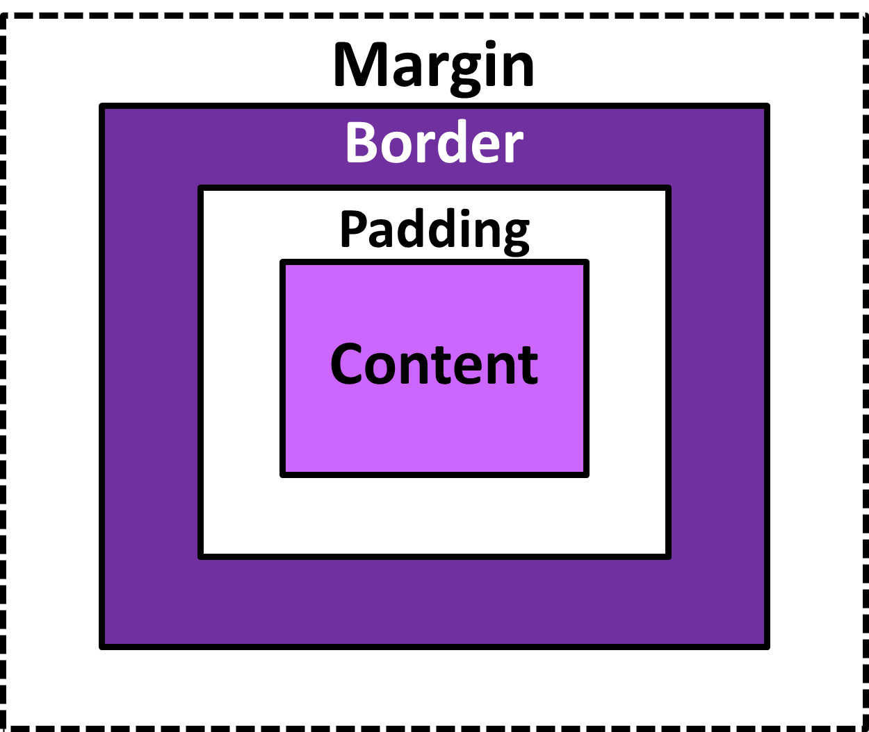
The Box Model
The Box Model wraps every CSS element in padding, border and margin – allowing developers to modify spacing styles.

Slide 18

CSS Positioning
We can orient our HTML elements in relation to space with CSS positioning (static, relative, fixed, absolute).

Slide 19









How to Learn…

Slide 20

General Questions / Issues?

Slide 21
Double Take

Slide 22
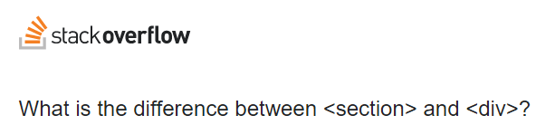
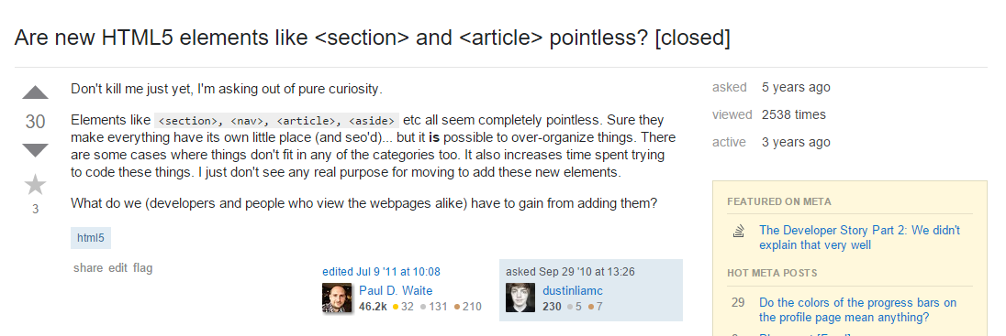
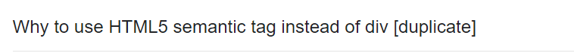
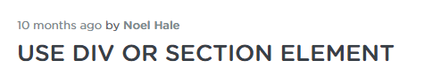
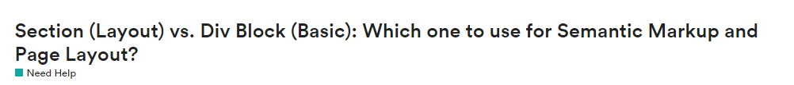
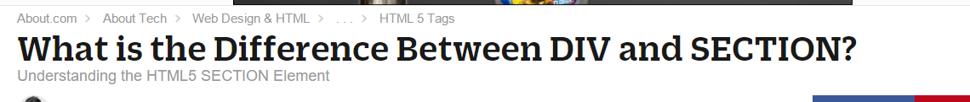
Divs, Sections, Navs, Etc….

Slide 23
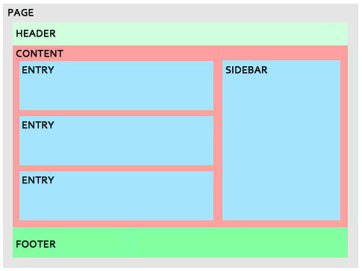
Divs, Sections, Navs, Etc….
All web layouts are inherently composed of containers, traditionally called “divs.”

Slide 24
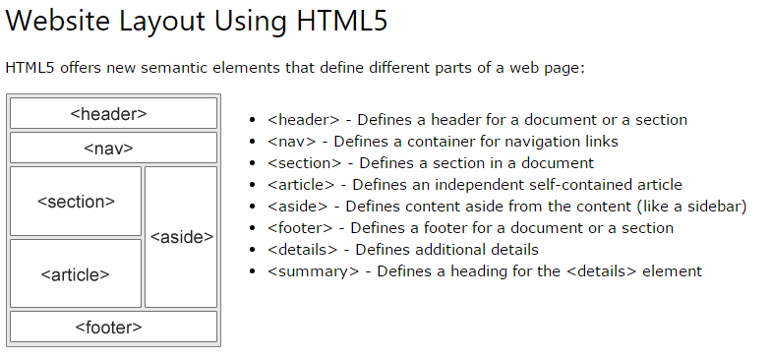
Divs, Sections, Navs, Etc….
HTML5 introduced the concept of “semantic layouts,” meaning “divs” could be given more meaningful names.
In theory, this helps with organization and search engine optimization.

Slide 25
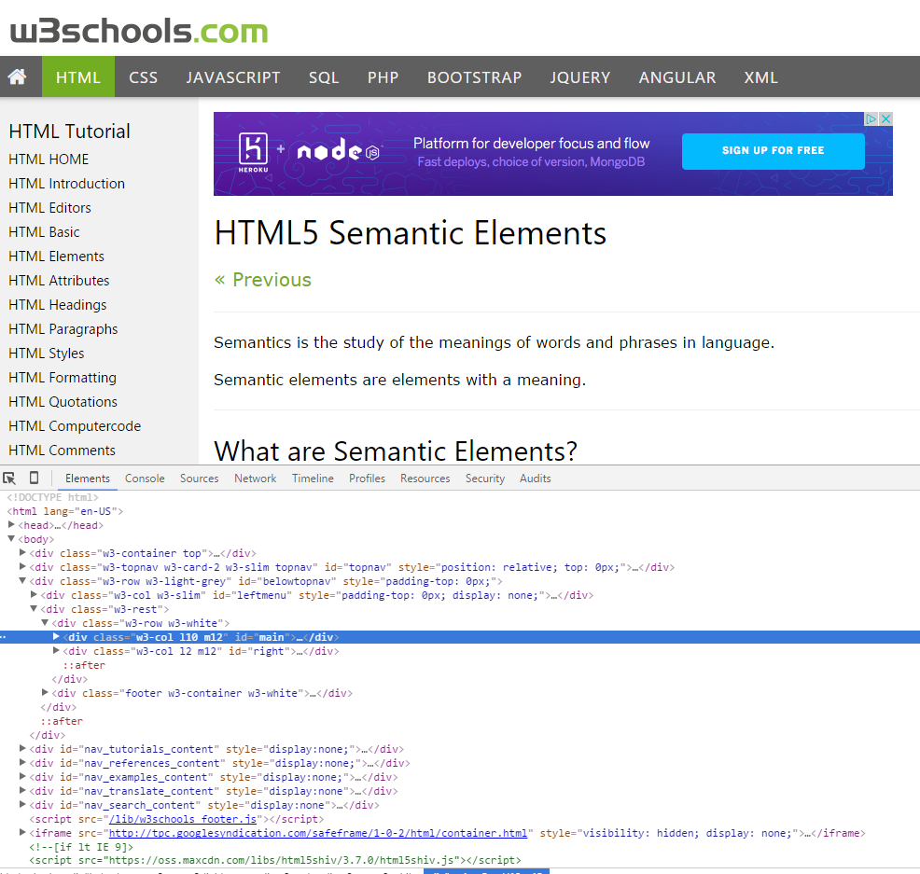
Divs, Sections, Navs, Etc….
That said… many (if not most) websites, seem to still be using basic divs.
There are reasons for this that we’ll showcase in later sections.
Additionally, it’s possible to include “semantics” by using id names and classes.

Slide 26
Divs, Sections, Navs, Etc….
div?
Section?
Bottom line: Follow your homework’s instructions. But when you get out in the “real world,” follow the convention of where you work!

Slide 27

Classes vs. IDs
Classes = Barcode (all iPod)
IDs = Serial Number (unique iPod)
When choosing between a CSS ID and a CSS Class follow the convention:
Classes (.classname) are to be used if the same style will be used on multiple HTML elements.
IDs (#idname) are to be used if a style is unique to that HTML element.

Slide 28
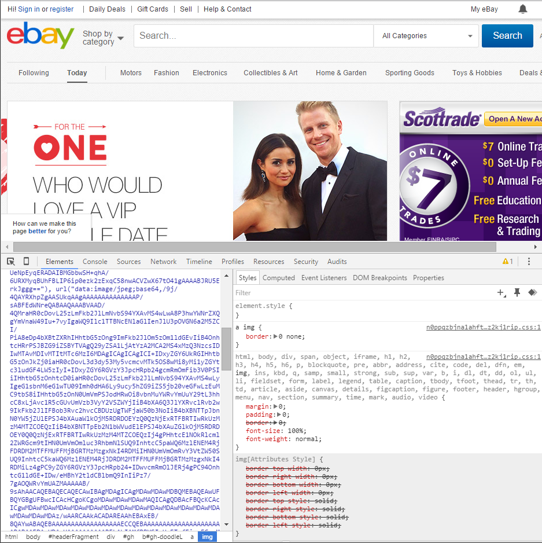
Chrome Developer Tools (Inspector)
This is one of the most frequent tools you will use in web development.
It allows you to truly debug your web designs.
Start using it!

Slide 29

Modifying Sites
You can edit any page’s HTML and CSS with Chrome Developer Tools.
Plus, you’ll see your results instantly.

Slide 30
INSTRUCTOR DEMO!
Instructor: Demo
(Chrome Developer Tools)
Notes:
30

Slide 31
> YOUR TURN!!
Suggested Time: 15 min
Assignment
For the next 15 minutes, take a website you commonly use (Amazon, Google, Huff Po, etc.) and heavily modify it using the Chrome Developer Tools.
Be sure to at least modify:
Content (Change words)
Colors
Spacing
Send a screenshot to the class’s slack profile when you’re done.

Slide 32
> YOUR TURN!!
Suggested Time: 10 min
Assignment
For the next 10 minutes, edit any site that you’ve been working on in-class or for homework with Chrome Developer Tools.
Be sure to at least modify:
Content (Change words)
Colors
Spacing

Slide 33
CSS Resets

Slide 34

Loading Multiple CSS Files ***(Very Important!!!)***
An incredibly powerful technique: deploying multiple CSS files simultaneously.
This lets developers to create complex designs made up of abounding design elements.
Just remember: the loading order matters!!!

Slide 35
INSTRUCTOR DEMO!
Instructor: Demo
(1-3_CSSFiles.html | 3-MultipleCSS)
Notes:
35

Slide 36
What Browser?
By a show of hands…
Which browser do you use?

Slide 37

Battle of the Browsers
Under the hood, web browsers often render web pages differently than their competition.
These disparities could mean HTML/CSS displaying differently in each web client.
Because of these potential divergences, web developers need to make their websites cross-browser compatible.

Slide 38

Reset.css (or Normalize.css)
Reset.css will “reset” all browser-specific CSS. This means your site will appear the same in all browsers.
However, you will have to re-style everything yourself.

Slide 39
INSTRUCTOR DEMO!
Instructor: Demo
(Example.html | 4-ResetCSS)
Notes:
39

Slide 40
Why CSS Resets Matter
It’s important for creating browser-compatible websites
It’s an example of using someone else’s CSS in your website!!!
It’s a common Front-End Developer Interview question.

Slide 41
> YOUR TURN!!
Suggested Time: 10 min
Assignment
Follow the instructions given via Slack to incorporate a reset.css file into a basic HTML file.
Note the impact the reset file makes after its inclusion.

Slide 42
To the Web with GitHub!

Slide 43
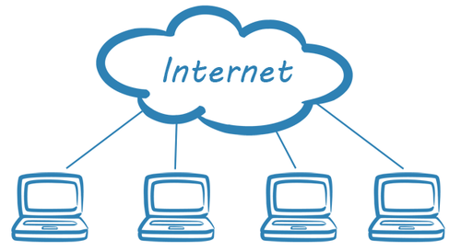
The Internet
A deep and complex diagram above on how the internet works.

Slide 44
The World Will See Our Greatness!
GitHub provides hosting for static websites – which means we can deploy our websites and applications onto their servers for the world to see.

Slide 45
Together Now…
Let’s all login to GitHub

Slide 46
INSTRUCTOR DEMO!
Instructor: Demo
(GitHub Pages Deployment - Personal)
Notes:
46

Slide 47
Deploying Static Personal Site – GitHub Pages
Basic Steps:
Create a new repo that is named `_username_.github.io`
Navigate into a folder and clone the repo into it
Build your files
Add, commit, and push your changes into the repository

Slide 48
> YOUR TURN!!
Suggested Time: 15 min
Assignment
Time to take your newfangled website and deploy it to the cloud (in this case, GitHub Pages).
Additional instructions to be sent via Slack.

Slide 49
INSTRUCTOR DEMO!
Instructor: Demo
(GitHub Pages Deployment - Project)
Notes:
49

Slide 50
Deploying a Static Project Site – GitHub Pages
Basic Steps:
1. Create a new repository on your GitHub account. You can name this repository whatever you would like.
2. Once inside of the repository, create a new file and name it `index.html`
3. Add some very basic HTML into this file, save it, and then navigate into your repository's Settings tab.
4. Scroll down to the GitHub Pages section and then, in the section labeled "Source", select that you would like to use the master branch as your source.
5. Navigate to `<username>.github.io/<repositoryname>` and you will find that your new web page has gone live!

Slide 51
> YOUR TURN!!
Suggested Time: 15 min
Assignment
Build a newfangled website, and deploy it to GitHub Pages as a project instead of a personal site.
Additional instructions to be sent via Slack.

Slide 52
Practice Through Frustration
Keep Practicing!
It gets better.

Slide 53
Questions?

Slide 54
Homework 1 - Help?

Slide 55
EXTRA MATERIAL

Slide 56
And Back to Git…

